Slide 1
Automated Detection and Classification of 3D Printing Failures Using Image Processing and Deep Learning
A Reproducible Scratch-vs-Pretrained Study
Khang Duong - CS 898BA - Final Presentation

Slide 2
The Problem
Failure classes detected: Spaghetti, Layer Cracking, Over Extrusion, Stringing, Warping
Why it matters
Undetected print failures waste filament, waste printer time, and require constant manual inspection during long prints
Automated, per-frame defect detection can catch failures early and reduce wasted material and operator time
Final objective
Localize defects with bounding boxes
Classify defect type across five classes
Compare a one-stage and a two-stage detector
Evaluate image-processing and training-system decisions
Notes:
Print failures like spaghetti, layer cracking, over extrusion, stringing, and warping waste filament, waste machine time, and currently require someone to babysit the printer. My final objective was fourfold: localize defects with bounding boxes, classify the defect type, compare a one-stage and a two-stage detector head-to-head, and evaluate whether image-processing and training-system decisions actually helped.

Slide 3
Literature and Design Rationale
Idea | Influence on project
One-stage YOLO-style detection | Fast, end-to-end localization
Faster R-CNN | Region proposals and a precise two-stage alternative
CLAHE / edge processing | Domain-specific contrast and structure analysis
Pretraining literature | Expected practical advantage of pretrained detectors
Custom YOLO26-style detector: fast, one-stage design built from scratch for direct box + class prediction in a single pass. | Custom Faster R-CNN: ResNet-style backbone with FPN, RPN, RoI Align, and per-class NMS — a two-stage, region-proposal alternative.

Slide 4
Data Auditing Changed the Protocol
Final dataset: 5 classes — Spaghetti, Layer Cracking, Over Extrusion, Stringing, Warping
3,421 records across 823 source / perceptual groups
3 grouped folds, ~2,280 train images per fold
The audit
Original exported splits had duplicate-content overlap and annotation disagreement
The public candidate test split was excluded from all reported results
Results are grouped-validation estimates, not independent deployment claims (verified in cv_summary.json)
Notes:
Before I could trust any result, I had to fix the data. My final dataset covers five classes, and after grouping by source and perceptual similarity, I built a trustworthy grouped-CV protocol. I found the original exported splits had duplicate-content overlap and annotation disagreement, so I excluded the public candidate test split entirely.

Slide 5
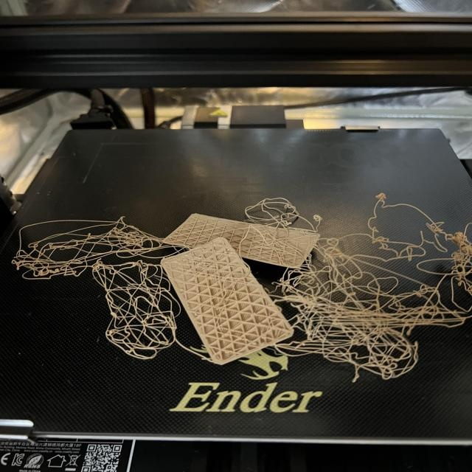
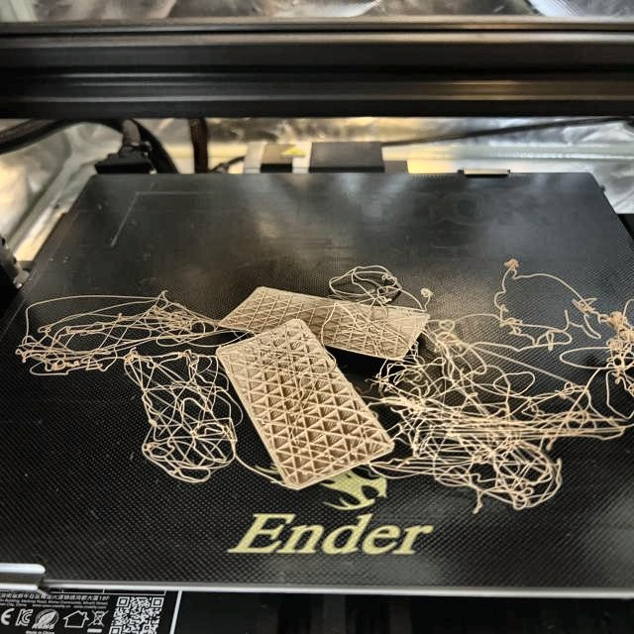
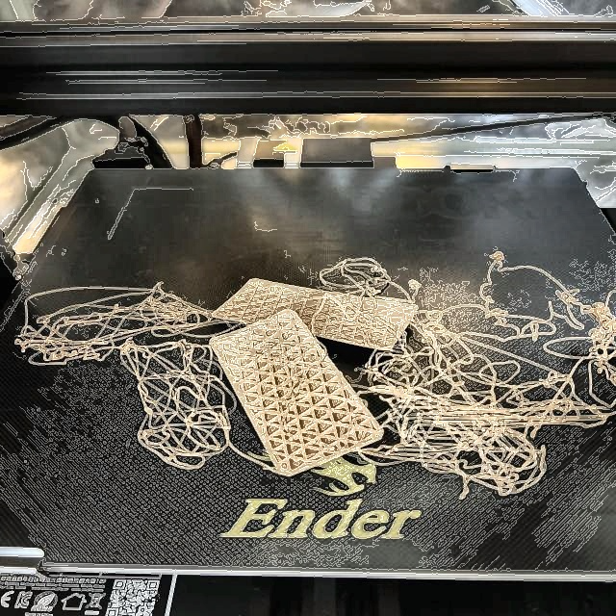
Image Processing
Pipeline: raw RGB + mixed labels → strict label audit → polygon-to-box normalization → RGB / CLAHE / CLAHE+Canny → detection training
Three preprocessing variants compared: RGB baseline, LAB + CLAHE, LAB + CLAHE + Canny
Finding: LAB + CLAHE improved detection performance over the RGB baseline; adding Canny edges on top (CLAHE + Canny) did not improve results further and was rejected
Largest domain-engineering contribution was the label-format repair, strict validation, and audit
Notes:
I treated image processing as something to test, not assume would help. The result: CLAHE plus Canny did not improve aggregate detection performance, so I rejected it. The biggest domain-engineering win was the label-format repair and validation work underneath everything else.

Slide 6
System Design: Final Architecture
Pipeline: input image → label / data validation → optional RGB / CLAHE / Canny → two detector branches → class-aware NMS → boxes, class, confidence → mAP / Precision (P) / Recall (R) / confusion matrix
The two detector branches run in parallel and are evaluated independently on the same folds
YOLO26-style (custom, ~2.66M params)
C3k2 backbone blocks, SPPF, C2PSA, PAN / FPN neck, dual one-to-many / one-to-one heads
Faster R-CNN (custom, ~28.86M params)
ResNet-style backbone, P3–P6 FPN, RPN, RoI Align, detection head
Baseline (RGB)
YOLO26
images and labels
Dataset Audit
LAB + CLAHE
Loss, mAP, Precision, Recall, per-class metrics
Faster R-CNN
LAB + CLAHE + Canny
Notes:
Here's the full pipeline. Two parallel detector branches, each producing boxes, class, and confidence through class-aware NMS. Important disclosure: this is a systems comparison, not a capacity-matched one.

Slide 7
Methodology: Reproducibility and Evaluation Design
Setting | Value
Seed | 42, fixed across all runs
Cross-validation | 3 grouped folds (source / perceptual groups)
Input resolution | 960 px
Operating threshold | 0.25 confidence for precision / recall
Ranked metrics | mAP50 and mAP50-95
Confusion matrix | Project metric implementation, background-aware
Test protocol | No public candidate test used for optimization
best.pt was selected by validation mAP50; validation loss remained the controller signal, which aligned checkpoint choice with the reported detection metric.

Slide 8
What Changed, and Why: Decision Timeline
Custom YOLO26 — mAP50 path
0.0615 (fixed focal / pos-weight, grouped-CV baseline) → 0.0782 (960px resolution) → 0.1127 (class-aware NMS) → 0.1270 (one-to-many inference branch) → 0.1586 (mAP50 checkpoint selection)
Custom Faster R-CNN — mAP50 path
0.0075 (pre-repair diagnostic, not a valid benchmark) → 0.0935 (RPN positive-supervision repair) → 0.3191 (mAP50 checkpoint selection) → 0.3258 (warmup / cosine schedule)
The RPN repair was a correctness fix, not ordinary tuning — it recovered a broken training signal
Notes:
This slide shows what actually moved the needle, as a decision timeline rather than a giant grid search. The RPN fix wasn't ordinary tuning; it was a correctness repair to a broken training signal.

Slide 9
Systematic, Not Random: Accepted vs. Rejected
Treatment | YOLO26 | Faster R-CNN
One-to-many inference + NMS | Accepted | N/A
mAP50 checkpoint selection | Accepted | Accepted
Warmup / cosine schedule | Rejected | Retained cautiously
P2 small-object path + controller | Rejected | Rejected
DFL box regression | Rejected | N/A
ImageNet transfer | N/A | Rejected
Horizontal-flip TTA | Rejected | Rejected
EMA | Rejected | Rejected
Online photometric augmentation | Mixed / not adopted | Rejected
Full decision record: PROJECT_WORK_LOG.md

Slide 10
Headline Results: Final Scratch-Model Scorecard
Model | mAP50 | mAP50-95 | Precision | Recall
Custom YOLO26 (fixed LR, raw weights) | 0.1586 ± 0.0104 | 0.0512 ± 0.0043 | 0.1106 | 0.1306
Custom Faster R-CNN (cosine schedule, raw weights) | 0.3258 ± 0.0275 | 0.1239 ± 0.0111 | 0.2960 | 0.1146
Faster R-CNN was the strongest custom scratch detector by ranked AP. YOLO26 remained the lighter, faster one-stage architecture. These are validation-selected, grouped-CV estimates — not independent final test scores.

Slide 11
Where Each Model Wins and Fails
Category | Custom YOLO26 (AP50) | Custom Faster R-CNN (AP50)
Spaghetti | 0.0379 | 0.0429
Layer Cracking | 0.0678 | 0.2507
Over Extrusion | 0.2740 | 0.5468
Stringing | 0.0535 | 0.2438
Warping | 0.3596 | 0.5446
Both systems struggle with diffuse Spaghetti. Faster R-CNN is substantially better on Layer Cracking, Over Extrusion, Stringing, and Warping.

Slide 12
Practical Context: Scratch vs. Pretrained References
Model | mAP50 | mAP50-95
Custom YOLO26 (scratch) | 0.1586 | 0.0512
Custom Faster R-CNN (scratch) | 0.3258 | 0.1239
Official YOLO26n (COCO-pretrained) | 0.4592 | 0.1942
Official YOLO11n (COCO-pretrained) | 0.4799 | 0.1979
The pretrained systems are practical references, not architecture-only comparisons — they differ in pretraining, loss implementation, augmentation, preprocessing, optimizer behavior, and NMS.

Slide 13
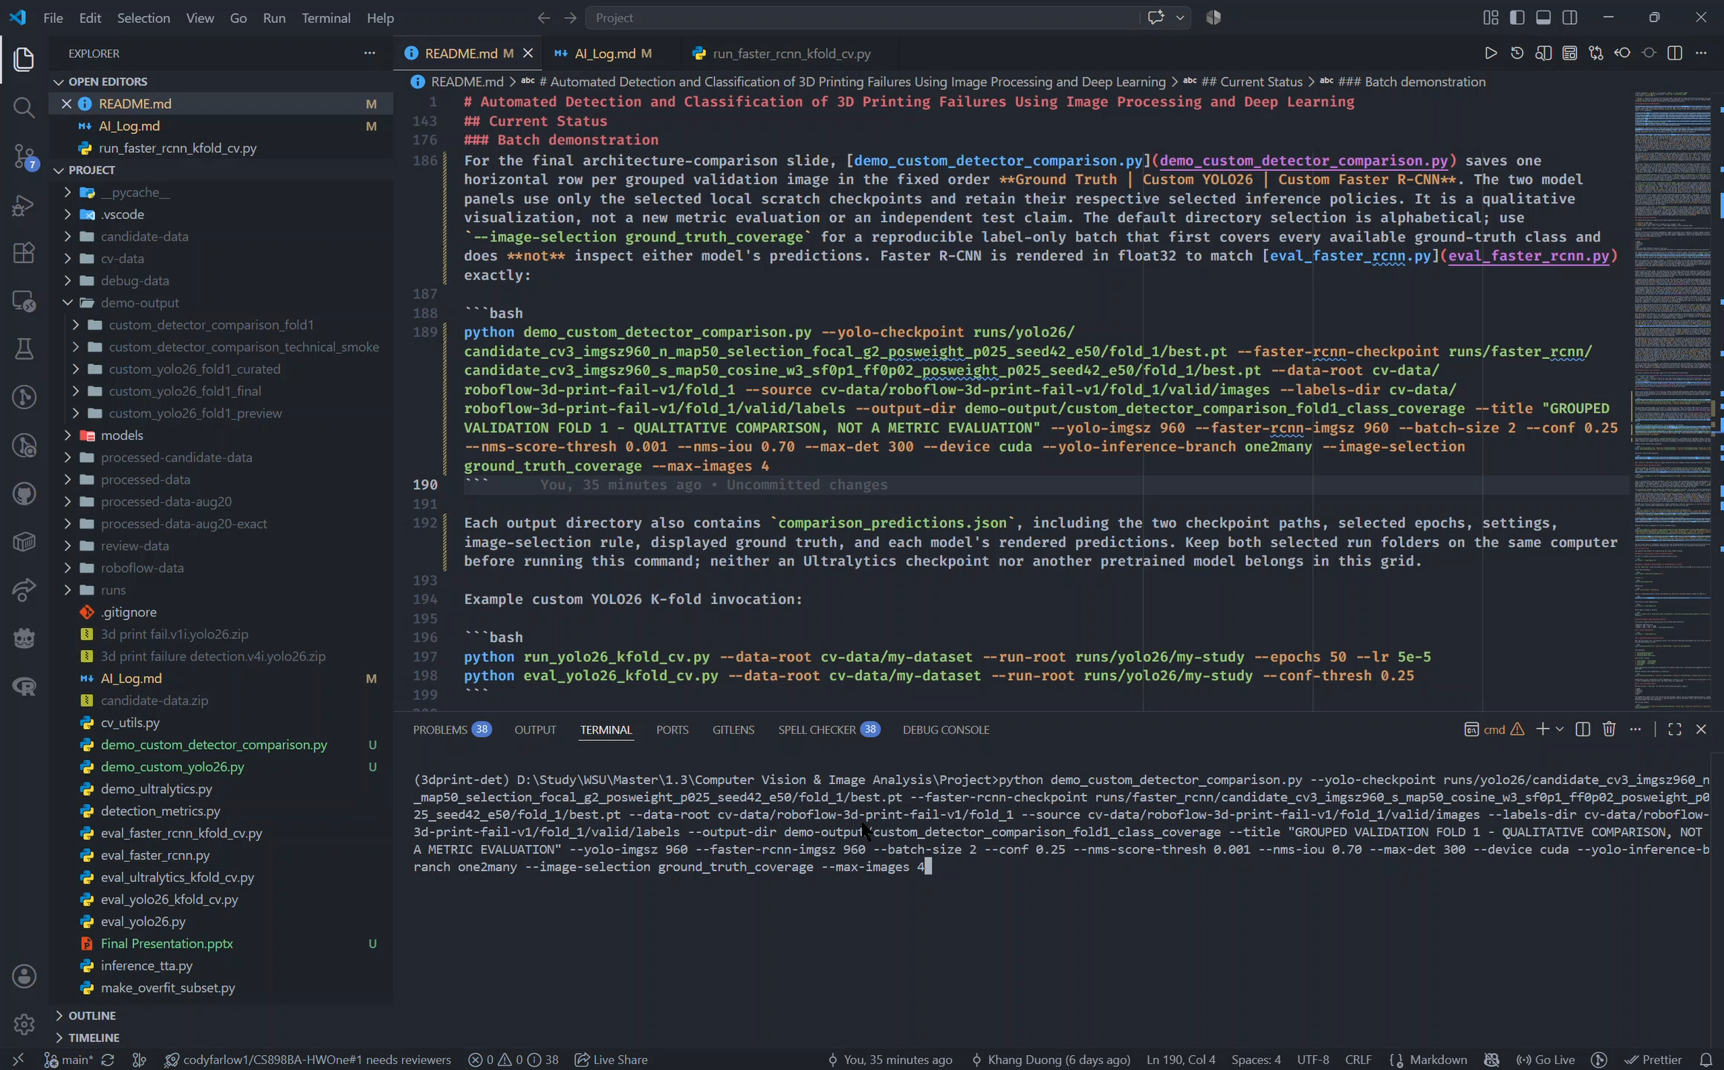
Live Walkthrough: Virtual Demonstration
Recorded walkthrough preview - full video is kept outside the repository copy.

Slide 14
Wrapping Up: Limitations, Conclusion, and Future Work
What Was Achieved | Limitations | Future Work
Two custom detector pipelines built end-to-end | Sparse minority classes | Acquire more independent source groups
Image processing, label normalization, strict validation, grouped CV, NMS, and metrics implemented | Diffuse / ambiguous defect boxes | Adjudicate annotations
Best scratch configurations identified | Duplicate content / annotation disagreement in original export | Reserve a clean, group-disjoint external test set
Practical pretrained reference built for demonstration | Validation folds reused for checkpoint / model decisions; no clean external held-out test claim | Pretrain the exact custom architectures before fine-tuning, if the goal shifts to practical performance
The main result is a reproducible, evidence-driven detector study that distinguishes implementation fixes, valid improvements, negative results, and the practical value of large-scale pretraining.

Slide 15
References
Hidayatullah, P., & Tubagus, R. (2026). YOLO26: A Comprehensive Architecture Overview and Key Improvements. arXiv:2602.14582. https://arxiv.org/abs/2602.14582
Ren, S., He, K., Girshick, R., & Sun, J. (2015). Faster R-CNN: Towards Real-Time Object Detection with Region Proposal Networks. arXiv:1506.01497. https://arxiv.org/abs/1506.01497
Mishra, A. (2021). Contrast Limited Adaptive Histogram Equalization (CLAHE) Approach for Enhancement of the Microstructures of Friction Stir Welded Joints. arXiv:2109.00886. https://arxiv.org/abs/2109.00886
Mikes Workspace. (2026). 3d print fail Object Detection Dataset (v1, 2026-03-18). Roboflow Universe. https://universe.roboflow.com/mikes-workspace-oebho/3d-print-fail-7ipuj/dataset/1. License: CC BY 4.0

